Slide 1
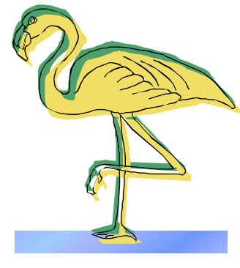
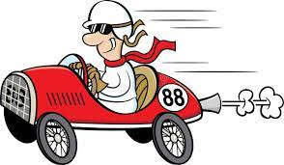
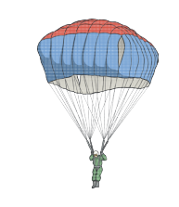
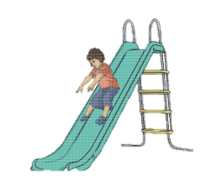
Free Body Diagrams
Name:
Free body diagrams are visual representations of the forces acting on an object. They are simplified pictures that show how big the forces are and what direction the forces are acting in. We use free body diagrams to easily see what is happening to an object and how its motion might change.
Rules for free body diagrams:
Forces are drawn as straight arrows.
The length of the arrow is the magnitude of the force (how strong it is).
The direction of the arrow is the direction the force is acting in.
You don’t need to be an artist. Simplify the object to a small circle or dot.
Include a label for each force.
Look at the examples then fill in the missing boxes for the other objects.
Picture
Description
Free body diagram
There are two forces acting on the flamingo. Normal force from the ground is pushing up. Gravity is pulling down.
These forces are equal.
Normal force
Weight
Normal force is pushing up. Gravity is pulling down. These forces are equal.
The applied force from the engine is pushing left. There is friction and air resistance pushing right.
Normal force
Applied force
Friction
Air resistance
Weight
Gravity is pulling down. Air resistance is pushing up.

Slide 2
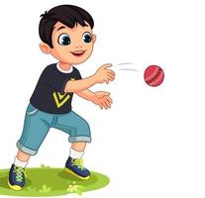
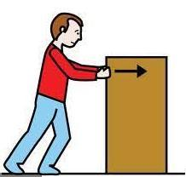

Picture
Description
Free body diagram
The ball is being thrown to the right. It experiences an applied force to the right. It also experiences gravity pulling it down and air resistance pushing it to the left.
A bookcase is being pushed to the left. It is getting faster.
A car is moving to the right and braking. It is slowing down.
Normal force
Friction
Weight
There is gravity pulling the object down. There is air resistance pushing the object up.
The object is getting faster so the force of gravity is greater than the force of air resistance.
Create your own

